Slide 1

Power BI Incremental refresh made simple
Notes:
Photo by <a href="https://unsplash.com/es/@jakobustrop?utm_source=unsplash&utm_medium=referral&utm_content=creditCopyText">Jakob Braun</a> on <a href="https://unsplash.com/photos/XK-aFVsgksE?utm_source=unsplash&utm_medium=referral&utm_content=creditCopyText">Unsplash</a>

Slide 2




Power BI Service
Azure SQL DB
IncrementalRefresh [DF]
IncrementalRefresh [DS]
IncrementalRefresh

Slide 3
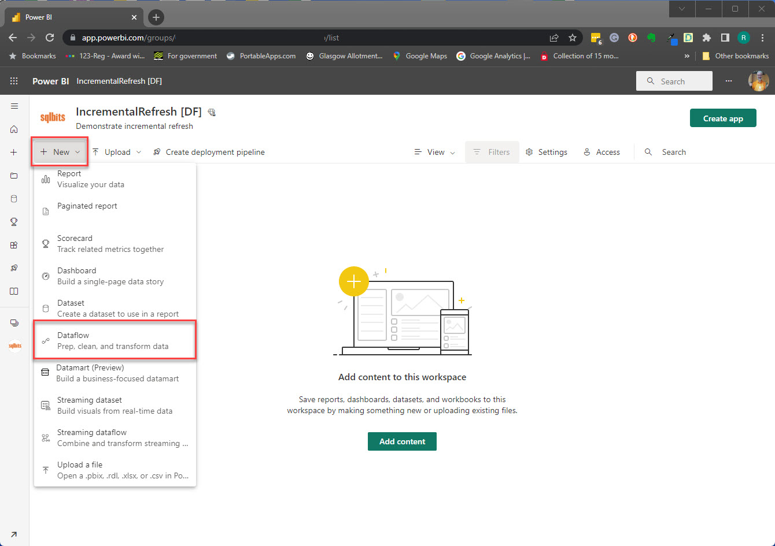

Slide 4
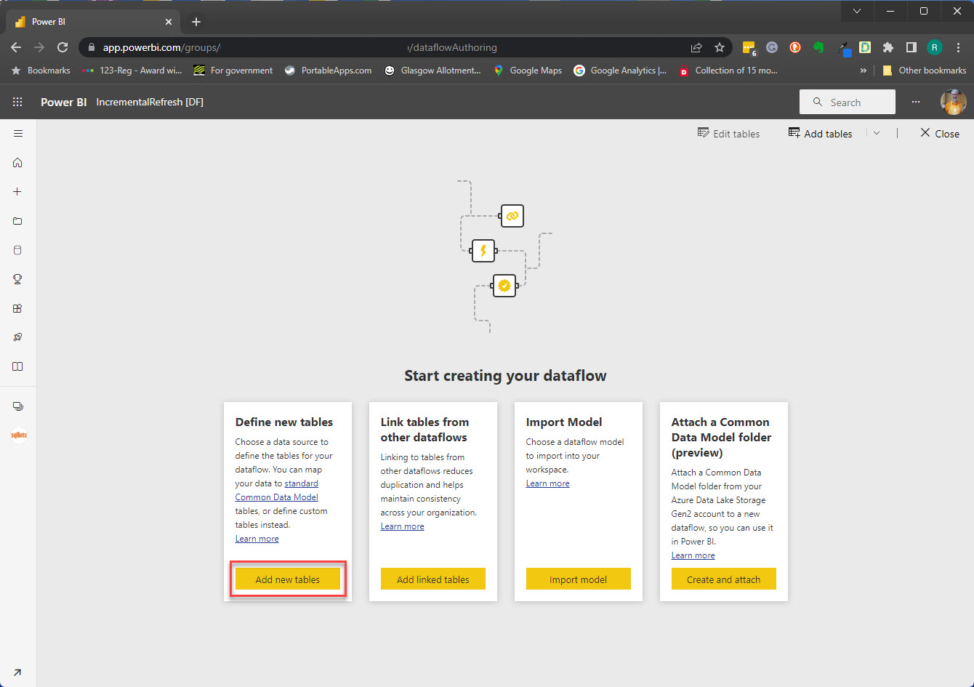

Slide 5
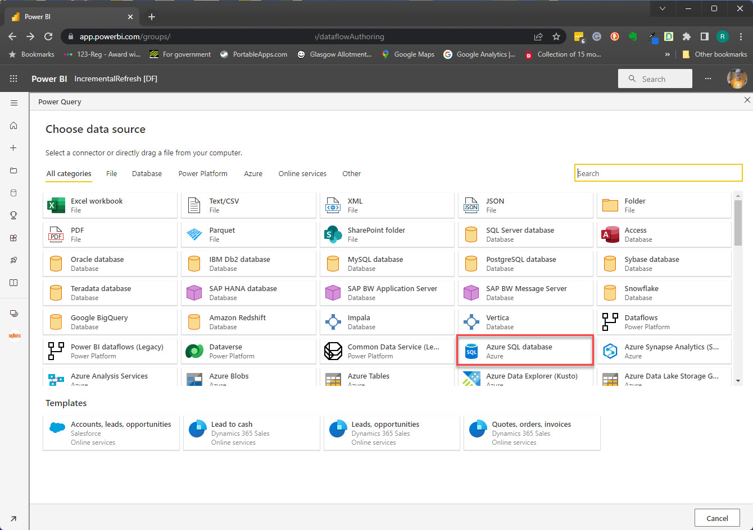

Slide 6
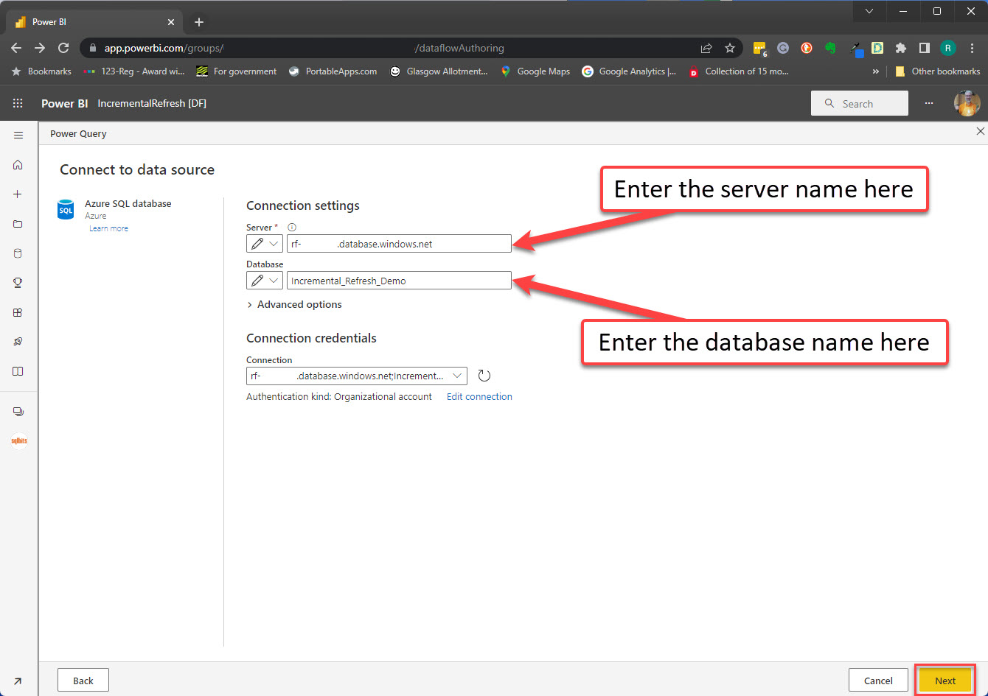

Slide 7
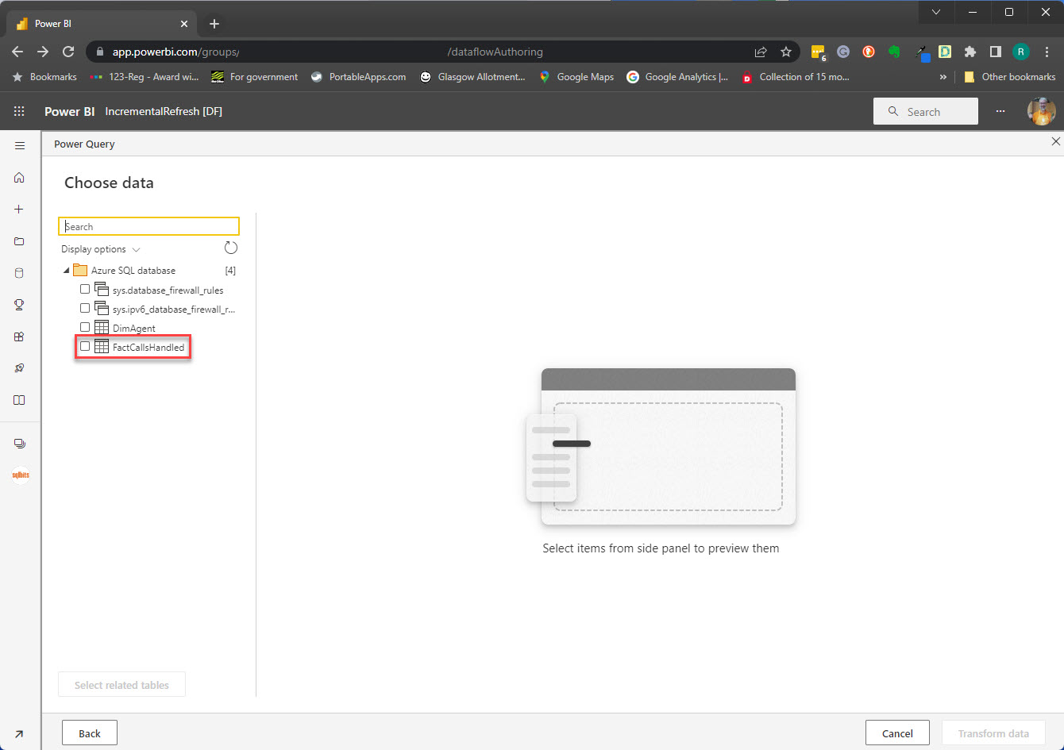

Slide 8
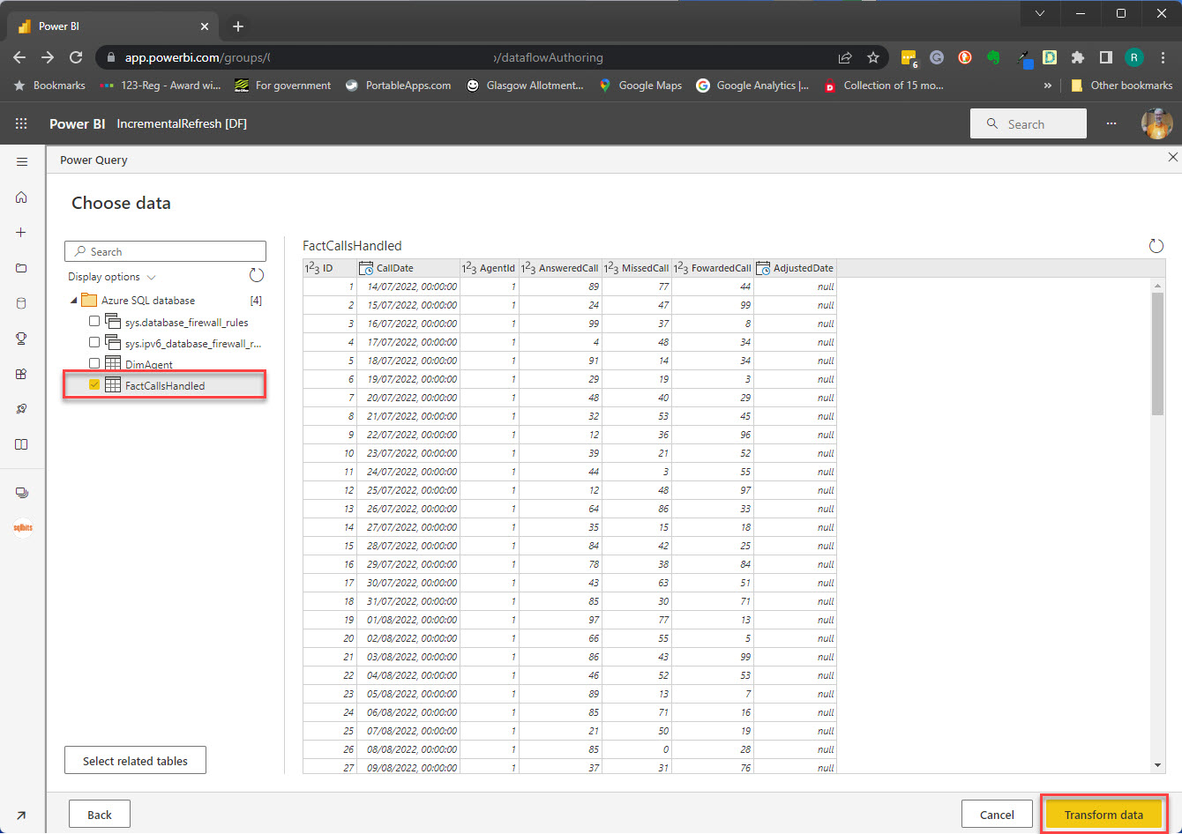

Slide 9
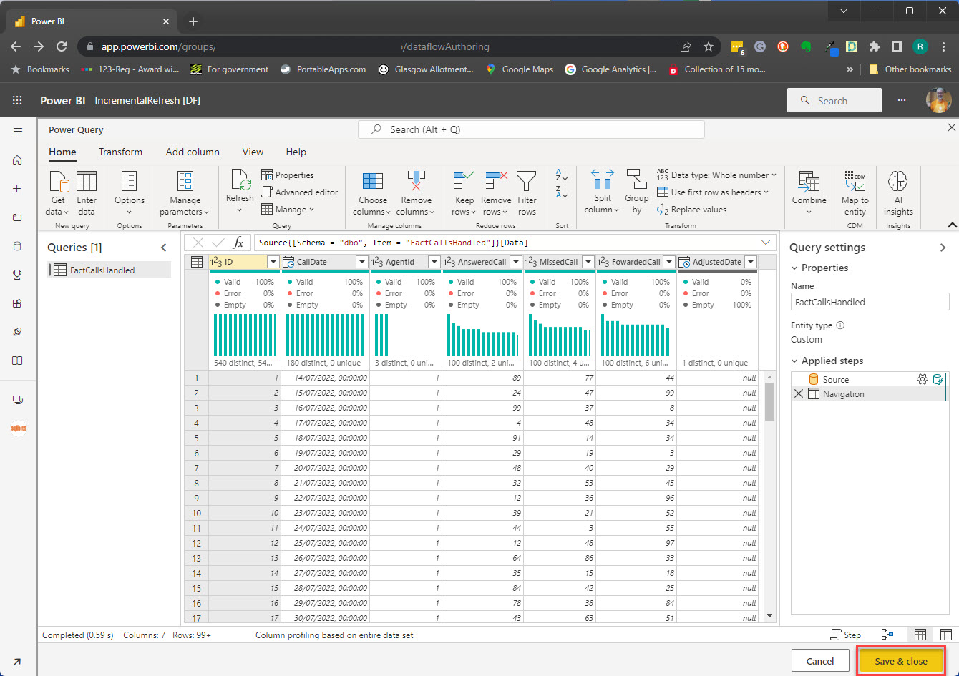
Notes:
Practical limit on how long can refresh a data source

Slide 10
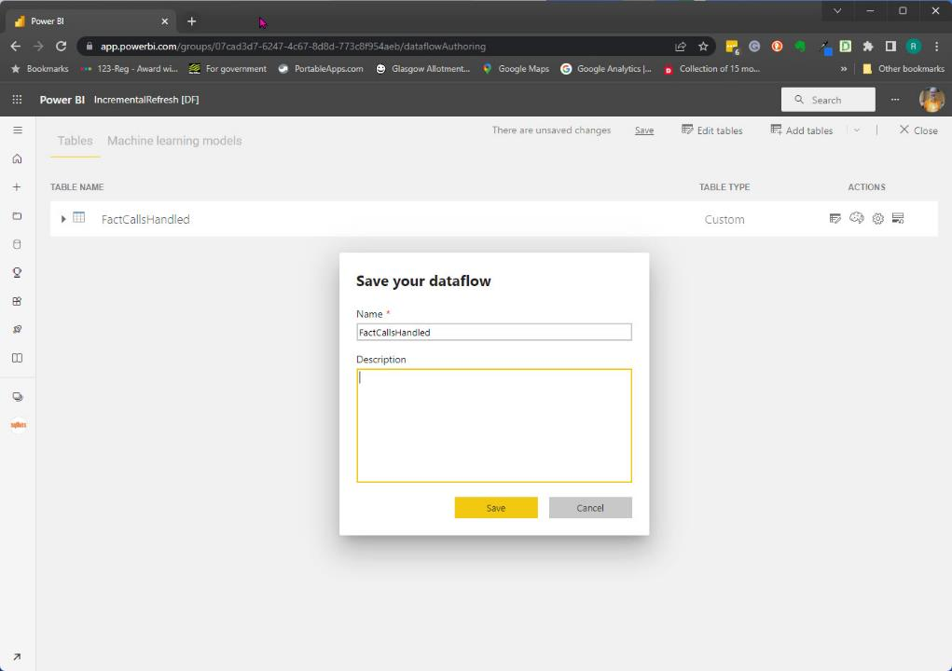
Notes:
https://unsplash.com/es/@harleydavidson

Slide 11
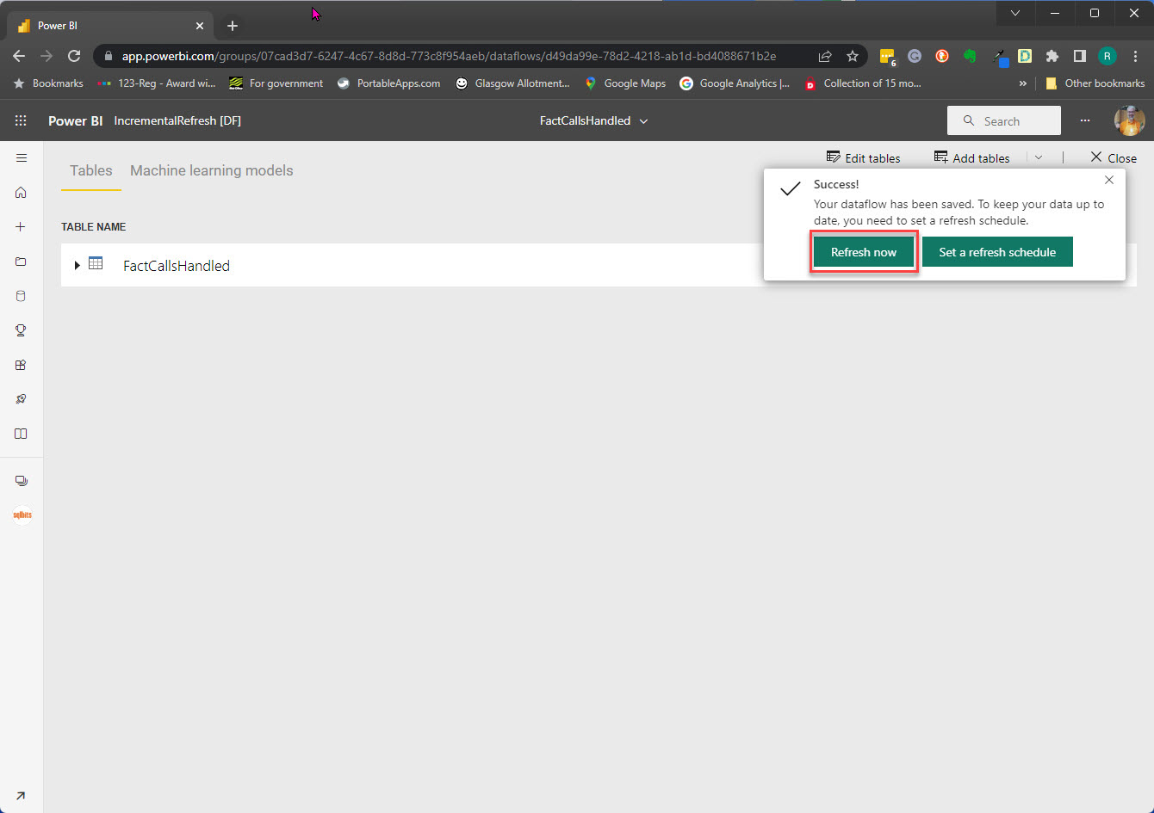

Slide 12
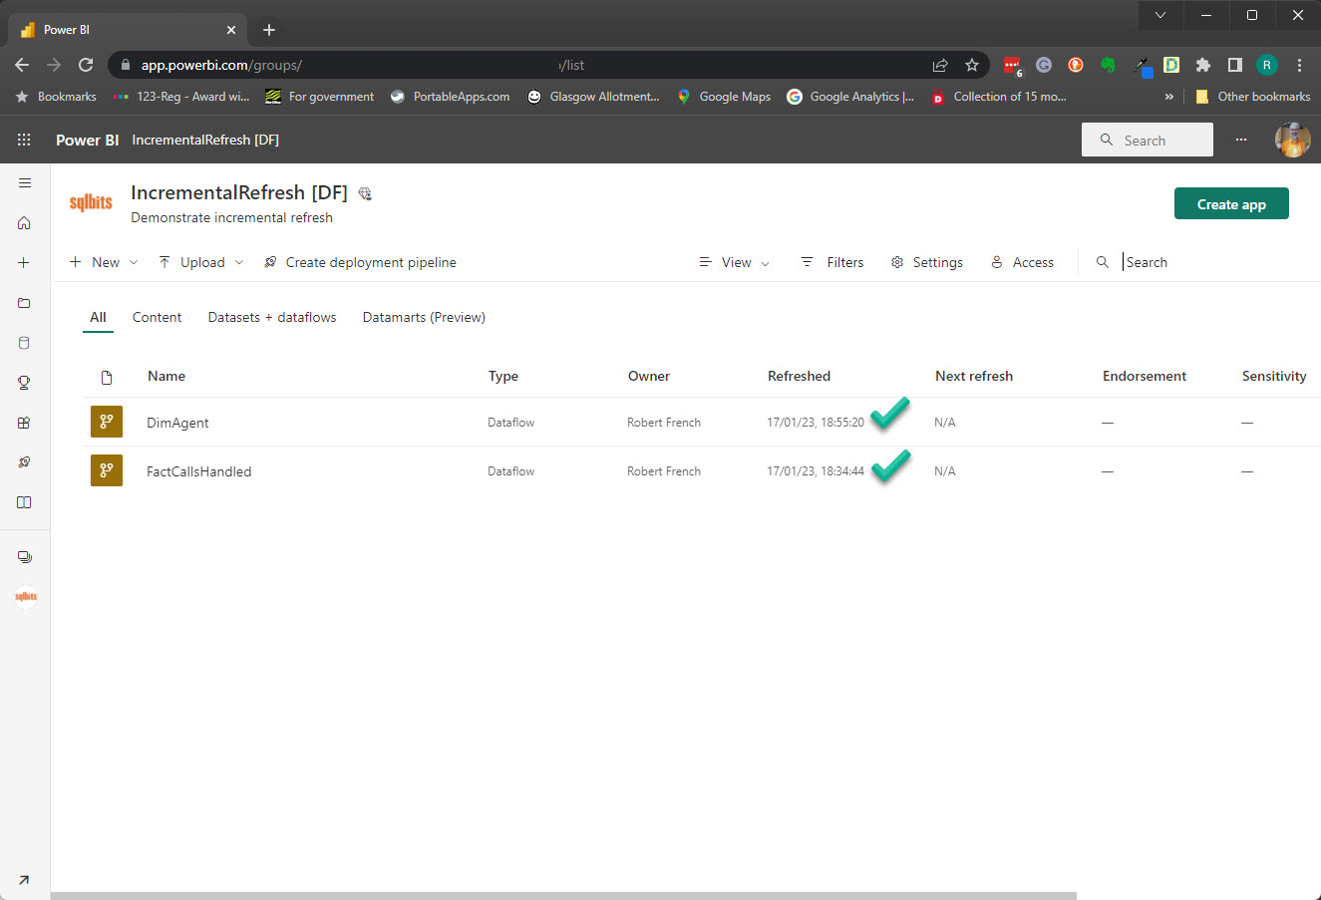

Slide 13

Data loaded into
the dataflow

Slide 14
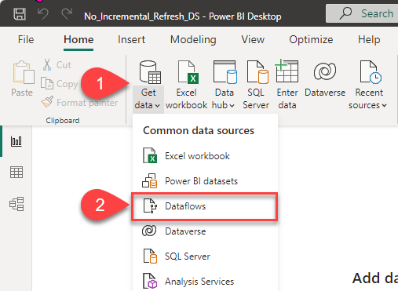

Slide 15
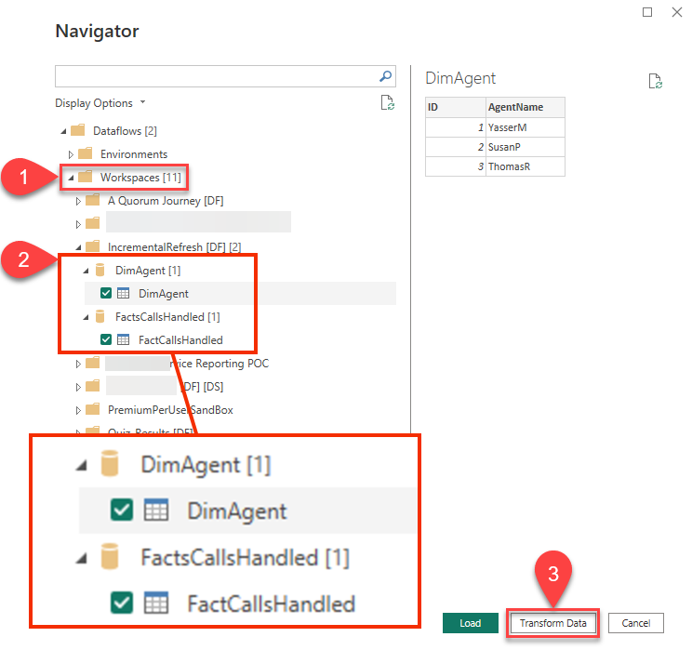

Slide 16
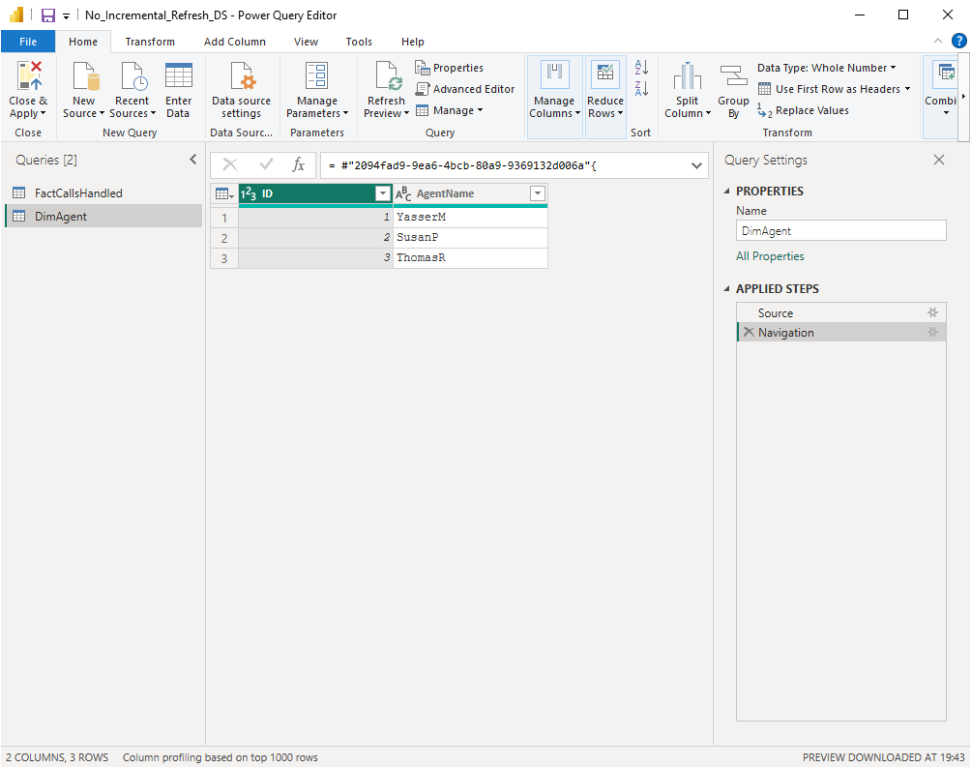

Slide 17
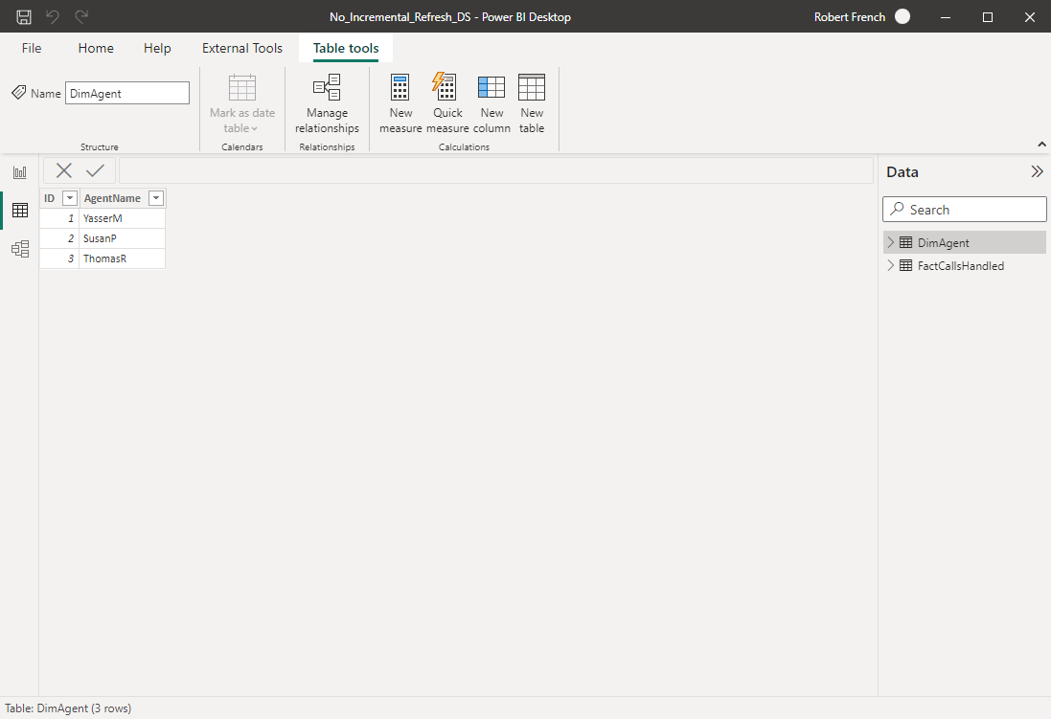

Slide 18
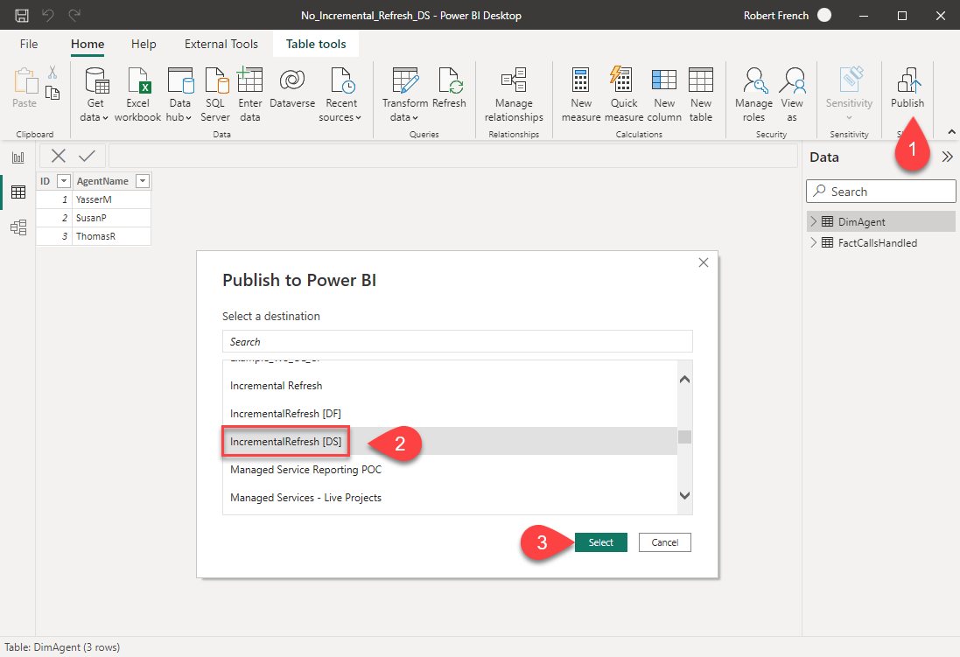

Slide 19
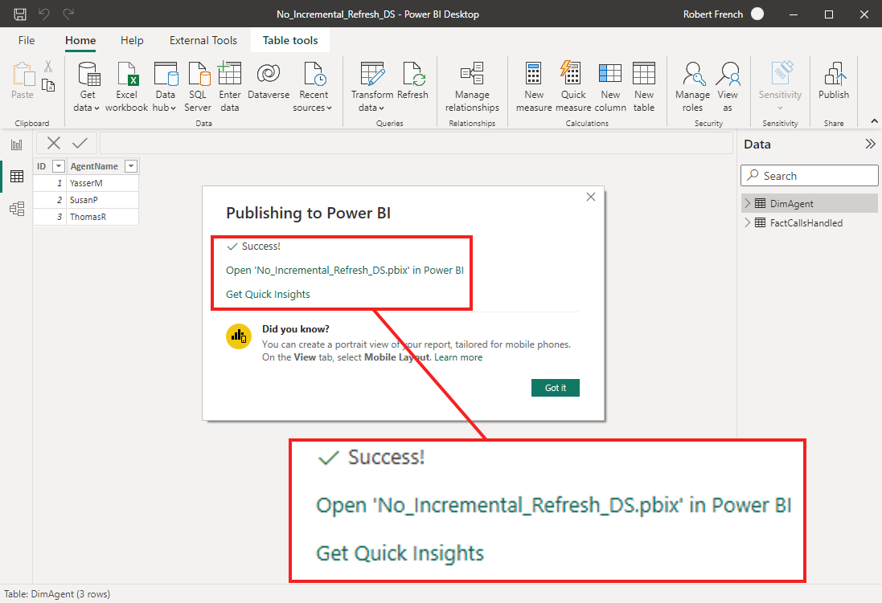

Slide 20
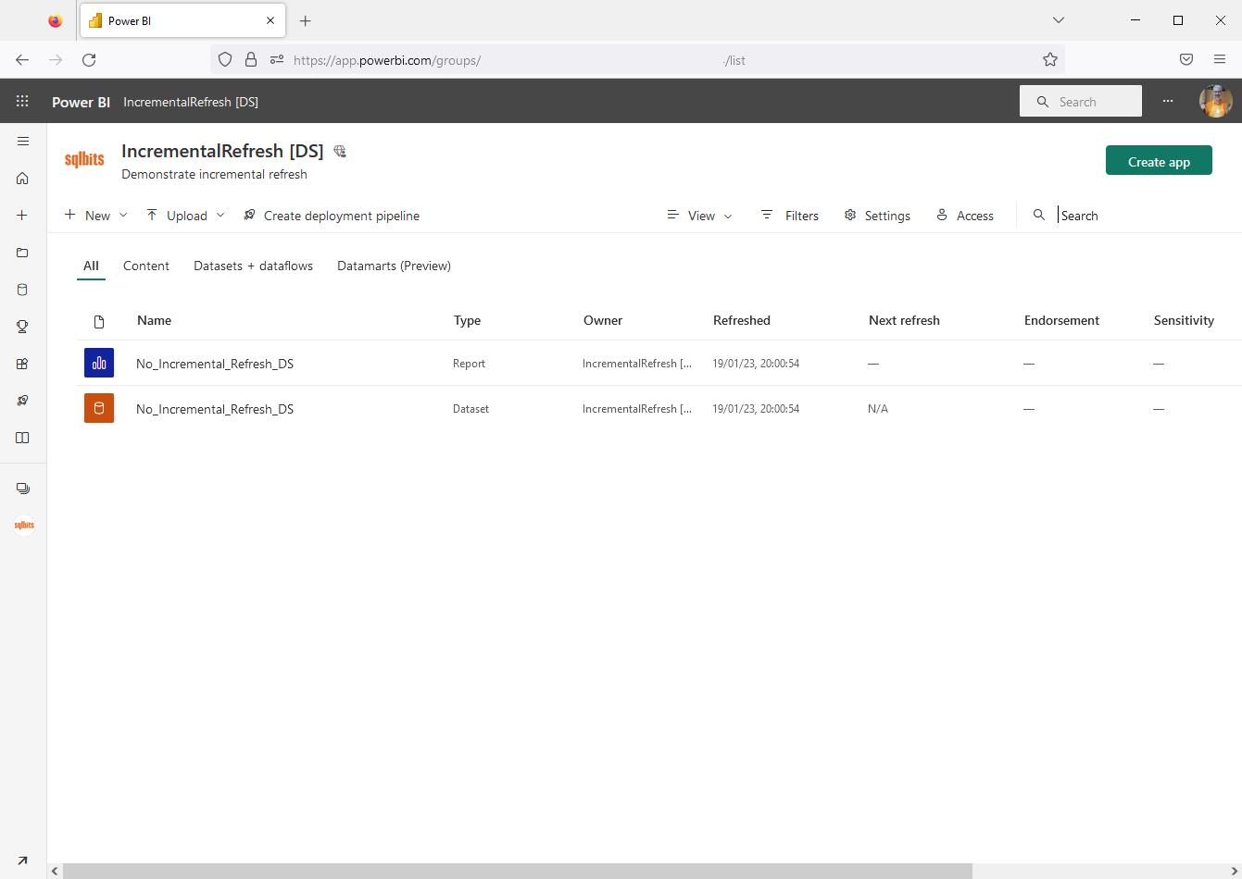

Slide 21
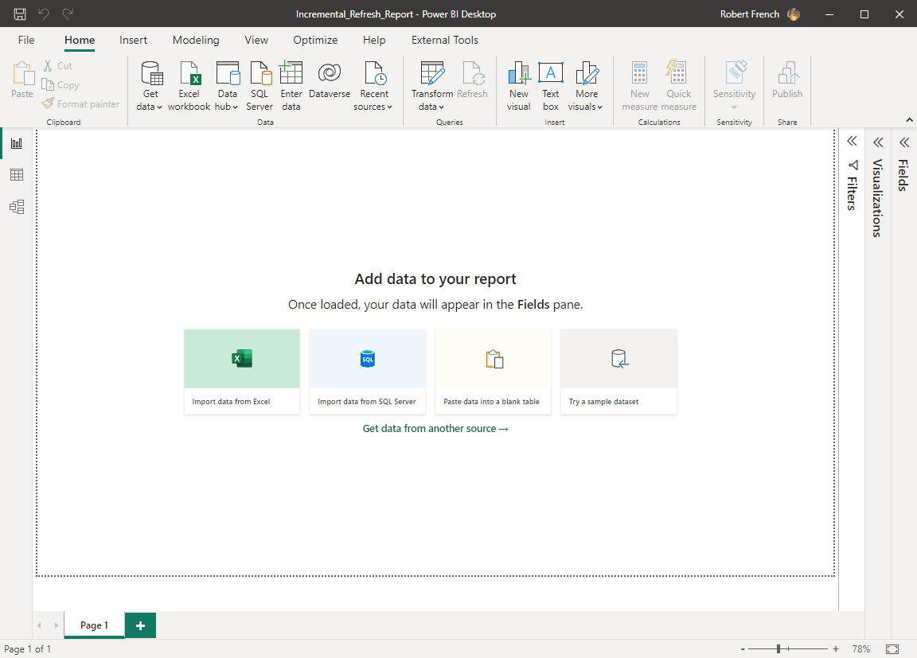

Slide 22
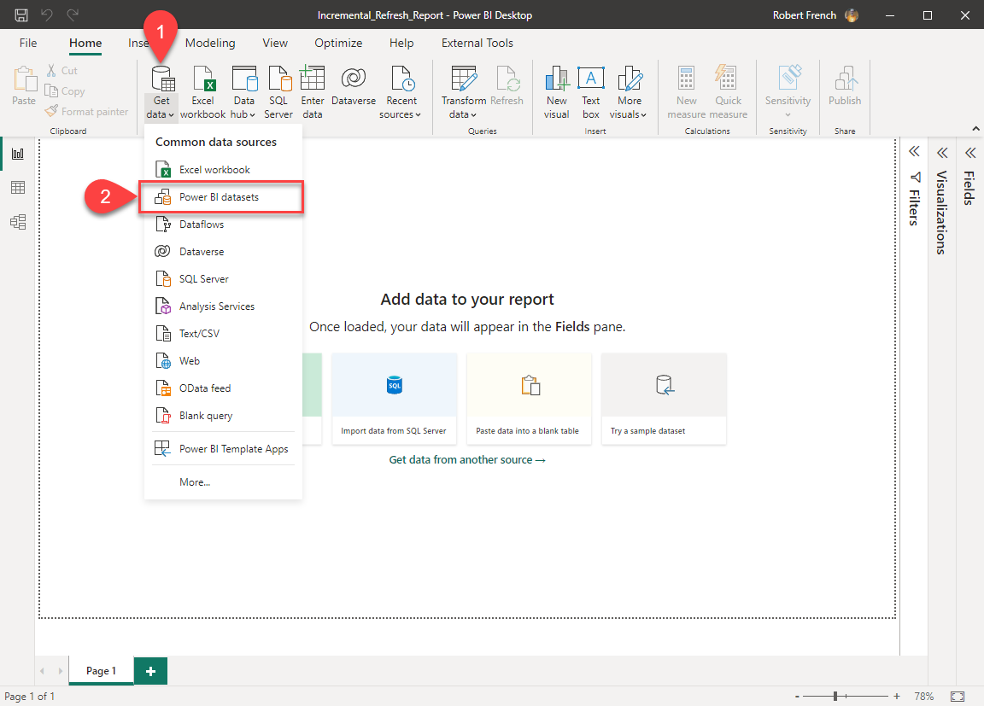

Slide 23
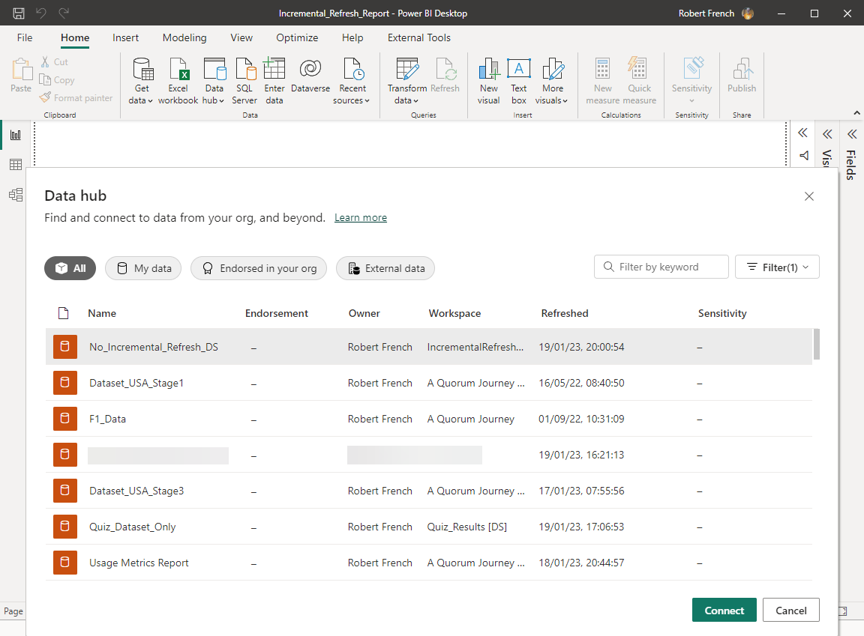

Slide 24
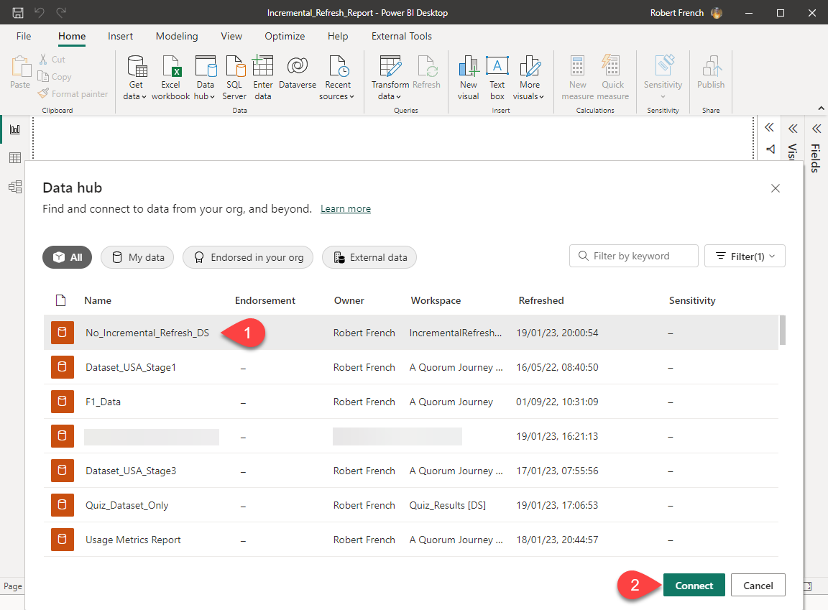

Slide 25
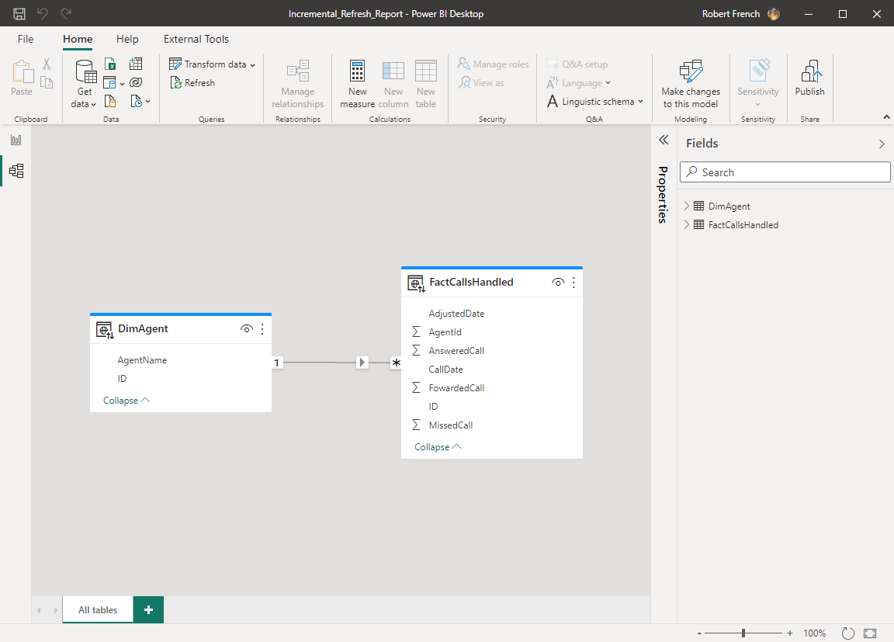

Slide 26
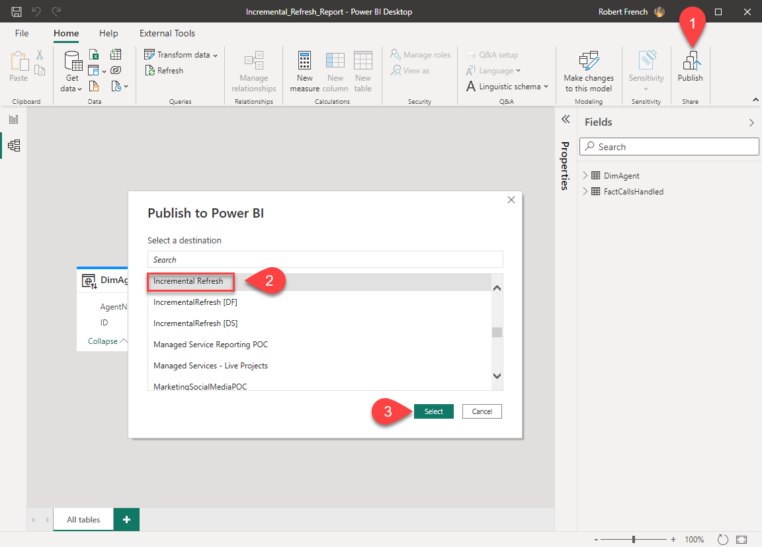

Slide 27
Power BI Service
Azure SQL DB
IncrementalRefresh [DF]
IncrementalRefresh [DS]
IncrementalRefresh

